Slide 1
Response Modeling Methodology (RMM)
A New Approach to Empirical Modeling of Variation
Haim Shore, Ben-Gurion University, Israel
Auburn University, Industrial and Systems Engineering Deprt., March 06

Slide 2
References
BOOK:
[1] Shore, H. (2004). Response Modeling Methodology (RMM)- Empirical Modeling for Engineering and the Sciences. World Scientific Publishing Company. Singapore.
Published Papers:
[1] Shore, H. (2000a). General control charts for variables. International Journal of Production Research, 38(8), 1875-1897.
[2] Shore, H. (2001a). Modeling a non-normal response for quality improvement. International Journal of Production Research, 39 (17), 4049-4063.
[3] Shore, H. (2001b). Inverse normalizing transformations and a normalizing transformation. In “Advances in Methodological and Applied Aspects of Probability and Statistics”, Book, N. Balakrishnan (Ed.), Gordon and Breach Science Publishers. Canada. V. 2, 131-146,
[4] Shore, H. (2002a). Modeling a response with self-generated and externally-generated sources of variation. Quality Engineering, 14(4), 563-578.
[5] Shore, H. (2002b). Response Modeling Methodology (RMM)- Exploring the implied error distribution. Communications in Statistics (Theory and Methods), 31(12), 2225-2249.
[6] Shore, H., Brauner, N., and Shacham, M. (2002). Modeling physical and thermodynamic properties via inverse normalizing transformations. Industrial and Engineering Chemistry Research, 41, 651-656.
[7] Shore, H. (2003). Response Modeling Methodology (RMM)- A new approach to model a chemo-response for a monotone convex/concave relationship. Computers and Chemical Engineering, 27(5), 715-726.
[8] Shore, H. (2004a). Response Modeling Methodology (RMM)- Validating evidence from engineering and the sciences. Quality and Reliability Engineering International, 20, 61-79.
[9] Shore, H. (2004c) Response Modeling Methodology (RMM)- Current distributions, transformations, and approximations as special cases of the RMM error distribution. Communications in Statistics (Theory and Methods), 33(7), 1491-1510.
[10] Shore, H. (2004d). Response Modeling Methodology (RMM)- Maximum likelihood estimation procedures. Computational Statistics and Data Analysis. In press.
[11] Shore, H. (2005). Accurate RMM-based approximations for the CDF of the normal distribution. Communications in Statistics (Theory and Methods), 34(3). In press.

Slide 3
Two-Way Distinction
( to model Variation)
Modeling Systematic Variation vs. Modeling Random Variation
Theory-based Modeling vs. Empirical Modeling

Slide 4
Two-way Partition of Modeling Variation
Random Variation | Systematic Variation | Modeling:
Statistics (statistical distributions) | Science (relational models) | Theory-based
? | ? | Empirical

Slide 5
Scientific Relational Models
Kinetic Energy: E_{k}(V) = M (V²/2)
Radioactive Decay: R(t) = R₀ exp(-kt)
Antoine Equation: log(P) = A + B / (T+C),
Arrhenius Formula: R_{e}(T) = A exp[-E_{a}/(k_{B}T)]
Gompertz Growth-Model: Y= β₁exp[-β₂exp(-β₃x)]
Einstein’s: E = MC² / [1-(v/C)²]^{1/2}

Slide 6
Models of Random Variation
Normal Distribution
Exponential Distribution
Cauchy Distribution
Pearson Family of Distributions
Johnson Families (S_{B}, S_{U}, Log Normal)
Tukey’s g- and h- Systems of Distributions
Box-Cox transformations

Slide 7
Empirical Modeling of Random Variation (Current)
Random Variation | Systematic Variation | Modeling:
Statistics (Statistical distributions) | Science (Relational models) | Theory-based
Heuristics? Moment Matching? Percentile Matching? | ? | Empirical

Slide 8
Empirical Modeling of Systematic Variation (Current)
Random Variation | Systematic Variation | Modeling:
Statistics (Statistical distributions) | Science (relational models) | Theory-based
Heuristics, Moment Matching, Percentile Matching | ? | Empirical

Slide 9
Empirical Modeling of Variation (RMM)
Random Variation | Systematic Variation | Modeling:
Statistics (statistical distributions) | Science (relational models) | Theory-based
? | ? | Empirical

Slide 10
The RMM Model
Two questions:
- What is the error-structure of the relational models?
- Are there certain “patterns” that repeatedly appear in current relational models? (assuming monotone convex-concave relationships)

Slide 11
The RMM Model (1st question)
Antoine Equation (again):
log(P) = A + B / (T+C), B<0
[P-pressure, T- temperature (K⁰)]
What are the random errors associated with this model?
Suppose that T was “frozen” (namely, constant). Then (one option):
log(P) = A + B / (T+C) + ε₂, B<0
ε₂− Random error, representing:
“Self-generated Variation”

Slide 12
The RMM Model (Cont’d)
Since T is not constant, we can write:
T= μ_{T} + ε₁
ε₁− a random additive error, representing
“Externally-generated” random variation
Antoine Equation, with the errors:
log(P) = A + B / (μ_{T} + ε₁ +C) + ε₂, B<0

Slide 13
The RMM Model (2nd question)
What are the “repeated” patterns?
Kinetic Energy: E_{k}(V) = M (V²/2)
Radioactive Decay: R(t) = R₀ exp(-kt)
Antoine Equation: log(P) = A + B / (T+C),
Arrhenius Formula: R_{e}(T) = A exp[-E_{a}/(k_{B}T)]
Gompertz Growth-Model: Y= β₁exp[-β₂exp(-β₃x)]

Slide 14
The RMM Model
(axiomatic derivation)
Assume that “Self-generated” and “Externally generated” components of variation interact:
Y = f₁(η,ε₁; θ₁) f₂(ε₂; θ₂)
f₁- Modeling “Exernally-generated” variation
f₂- Modeling “Self-generated” variation
We now wish to model f₁ and f₂

Slide 15
The RMM Model
(axiomatic derivation)
Modeling “Self-generated” random variation (f₂):
One option (a proportional model):
f₂(ε₂; θ₂) = Μ(1+ ε₂)= Μ(1+σ_{ε2}Z₂)
M- Α central value, for example: the median
Z₂- A standard normal r.v.
Alternatively (ε₂ <<1): f₂(ε₂; θ₂) = exp(μ₂ + σ_{ε2}Z₂)

Slide 16
The RMM Model
(axiomatic derivation)
Modeling “Externally-generated” random and systematic variation (f₁):
“The Ladder of fundamental monotone convex/concave functions”

Slide 17
The RMM Model
(axiomatic derivation)
The “Ladder” (V=η+ε₁)
.
.
Exponential-exponential: exp[a exp(V)]
Exponential-power: exp(aV^{b})
Exponential: exp(V)
Power: Vª
Linear: V

Slide 18
The RMM Model
(axiomatic derivation)
Modeling “Externally-generated” random and systematic variation:
f₁(η,ε₁; θ₁) = exp{(α/λ)[(η+ε₁)^{λ} - 1]}
Does this represent well the “Ladder”?

Slide 19
The RMM Model
(axiomatic derivation)
f₁(η,ε₁; θ₁) = exp{(α/λ)[(η+ε₁)^{λ} - 1]}
Special Cases:
Linear: λ=0, α=1
Power: λ=0, α≠1
Exponential: λ=1
Exponential-power: λ≠0, λ≠1
Exponential-exponential: ??

Slide 20
The RMM Model
(axiomatic derivation)
f₁(η,ε₁; θ₁) = exp{(α/λ)[(η+ε₁)^{λ} - 1]}
Insert: exp{(β/κ)[(η+ε₁)^{κ} - 1]}
For κ=0, β=1:
exp{(β/κ)[(η+ε₁)^{κ} - 1]}= η+ε₁
Adding two parameters allows a repeat of the cycle “Linear-power-exponential”

Slide 21
The RMM Model
(axiomatic derivation)
Significance of the model for f₁:
The “Ladder” becomes a “conveyer” that takes one, in a continuous manner, from one point to the next on the
Spectrum of convexity intensity

Slide 22
The RMM Model
(axiomatic derivation)
The complete model:
f₁(η,ε₁; θ₁) f₂(ε₂; θ₂) = exp{(α/λ)[(η+ε₁)^{λ} - 1] + μ₂ + ε₂}
ε₁= σ_{ε1}Z₁, ε₂= σ_{ε2}Z₂, {Z₁, Z₂} from a bi-variate standard normal distribution with correlation ρ
Three sets of parameters:
- The linear predictor: η= β₀ + β₁X₁ + β₂X₂+..
- “Structural parameters”, {α, λ, μ₂}
- “Error parameters”, {ρ, σ_{ε1}, σ_{ε1}}
“Not all parameters were created equal”

Slide 23
The RMM Model
(axiomatic derivation)
Write: Z₂ | (Z₁=z₁) = ρz₁ + (1-ρ²)^{1/2}Z
The model, expressed in terms of independent standard normal variables:
W = log(Y) =
(α/λ)[(η+σ_{ε1}Z₁)^{λ} - 1]+μ₂+σ_{ε2} [ρΖ₁ + (1-ρ²)^{1/2}Z₂]
For: ρ = ±1, η = 1 (μ₂=log(Med.):
W= (α/λ)[(1+σ_{ε1}Z)^{λ} - 1]+μ₂+σ_{ε2}ρΖ, an INT

Slide 24
The RMM Model
(axiomatic derivation)
Eight variations of the RMM model
Two ways to write each error (ε₂<<1, ε₁<<η):
1+ε₂ ≅ exp(ε₂),
(η+ε₁)^{λ} = η^{λ}(1+ε₁/η)^{λ} ≅ exp[λlog(η)+λε₁/η]
Two equivalent forms to express the standard normal variables as indpendent (uncorrelated):
Z₂ | (Z₁=z₁) = ρz₁ + (1-ρ²)^{1/2}Z
Z₁ | (Z₂=z₂) = ρz₂ + (1-ρ²)^{1/2}Z

Slide 25
RMM Estimation
Phase 1:Estimating the linear predictor (Set I):
Canonical Correlation Analysis plus Linear Reg.
Phase 2: Iteratively alternating between Estimating Set II (the “Structural Parameters”) via W-NL-LS and Set II (the “Error Parameters”) via max. of log-likelihood

Slide 26
RMM Modeling: Random Variation
Modeling via the INT (ρ=±1, one variation):
Y= exp{(A/λ)[(1+ΒZ)^{λ} - 1]+log(M)+DZ}
Z- Standard normal
Examples:
- Approximations for the Poisson quantile and CDF of the Normal distribution
- Approximations for gamma

Slide 27
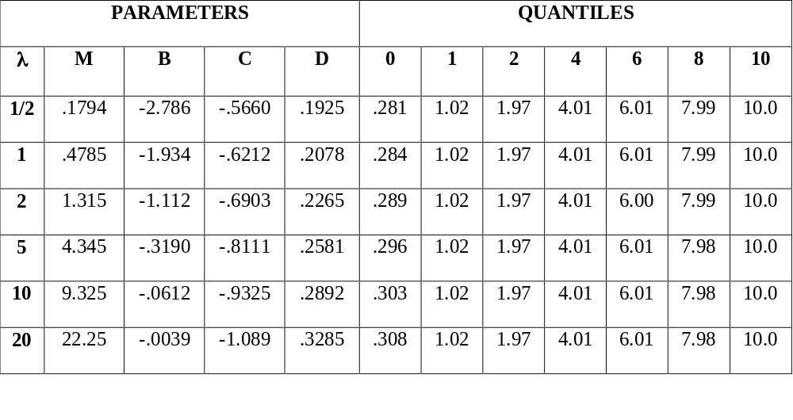
RMM Modeling (INT)- The Poisson
Source: Communications in Statistics (T&M), 33(7), 2004

Slide 28
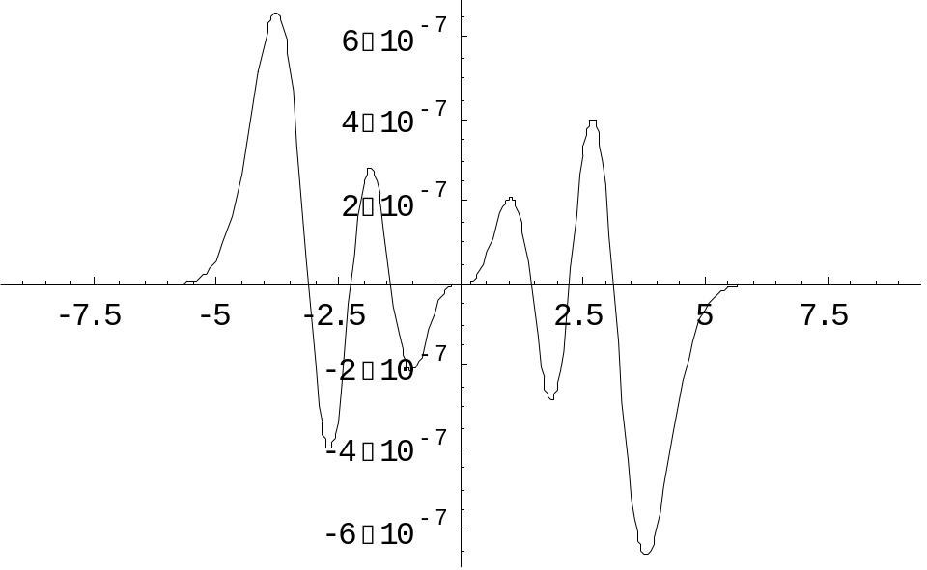
RMM Modeling (INT)- CDF of Standard Normal Distribution
For example: y= -log(1-P)= (M) exp{B[exp(Cz)-1] + Dz
(Source: Communications in Statistics (T&M), 34(3), 2005)

Slide 29
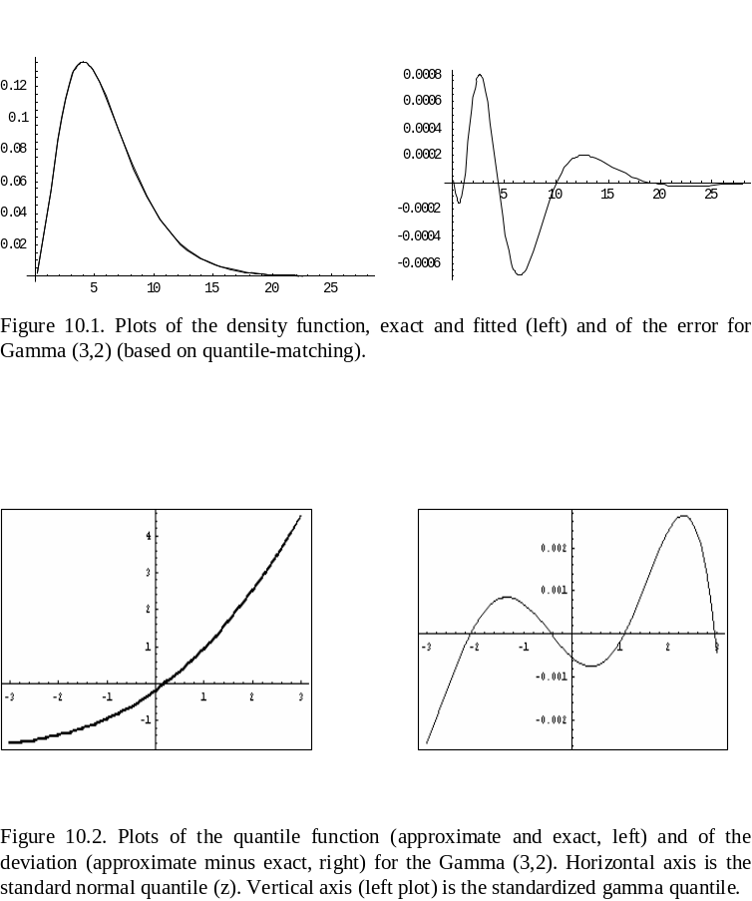
RMM Modeling (INT)- Gamma

Slide 30
RMM Modeling (for sample data)
Fitting and estimating procedures for modeling random variation have been developed:
- Maximum likelihood estimation
- Estimation by “Percentile-Matching”
- Estimation by “Moment-Matching” (two- moment, partial and complete)

Slide 31
RMM Modeling (for sample data)
Intra-Galactic Velocities (modeling random var.)
From Karian and Dudewicz (KD, 2000, p. 208). In astronomy, the cluster named A1775 is believed to consist of two clusters that are in close proximity. KD concluded that the generalized beta distribution (GBD) may model well this dataset (therein, p. 208). The four-parameter d.f. of GBD is given by (therein, p. 119):
f(y) = (y - β₁)^{β3} (β₁ + β₂ - y)^{β4} / [ β(β₃+1, β₄+1) β₂^{(β3+β4+1)}],
β₁≤ y ≤ β₁ + β₂

Slide 32
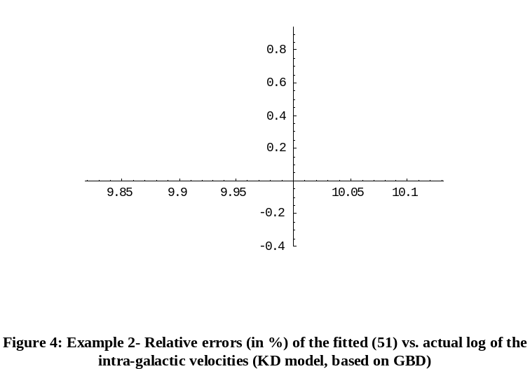
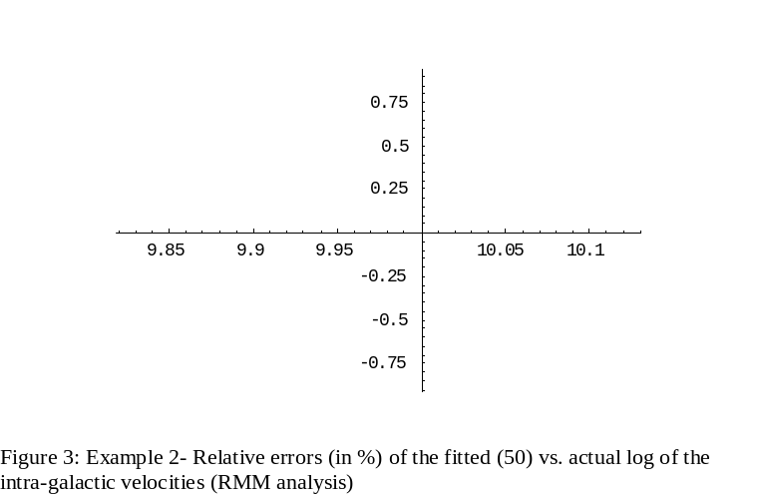
Intra-Galactic Velocities
(modeling random var.)
Average relative error: Beta (KD)- 0.28%; RMM- 0.39%
Source: Computational Statistics and Data Analysis, In press

Slide 33
The Wave-Soldering Process (modeling systematic variation)
GLM: Myers, Montgomery, Vining (2002, Book, John Wiley&Sons)
log(μ)=3.08 + 0.44C - 0.40G + 0.28AC - 0.31BD
μ^{1/2} = 5.02 + 0.43A - 0.40B + 1.19C - 0.39E - 1.10G + 0.58AC - 0.96BD (Poisson Model)
RMM: Shore (2004, Book, World Scientific Publishing)
η= -0.1786 + 0.16A - 0.14B + 0.53C - 0.16E - 0.49G + 0.22AC - 0.43BD (R²-adj.=0.848)
Comparison with the square-root link:
For A/C: RMM: 0.164/0.526= 0.31; GLM: 0.43/1.19= 0.36
For (AC)/(BD): RMM: 0.224/(-0.431)= -0.52; GLM: 0.58/(-.96)= -0.60.

Slide 34
RMM Modeling in Chemical Engineering
DIPPR (Design Institute for Physical Property Data)- A leading data-base for chemical properties and their modeling
Notation:
- The acceptable model: Model with best fit relative to the data set in the data-base
- Goodness-of-fit: By various measures for fit
(for example: R², AIC, MSE)

Slide 35
RMM Modeling in Chemical Engineering (Cont’d)
Substances examined (5): Water, Acetone, Benzoic acid, Ethane, Iso-propanol
Properties examined (13): Solid density, Liquid density, Solid vapor pressure, Vapor pressure, Heat of vaporization, Solid heat capacity, Liquid heat capacity, Ideal gas heat capacity, Liquid viscosity, Vapor viscosity, Liquid thermal conductivity, Vapor thermal conductivity, Surface tension

Slide 36
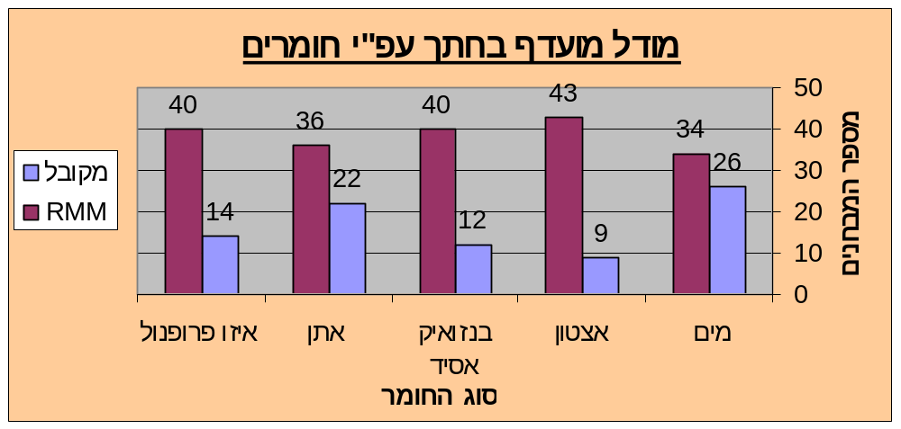
RMM Modeling in Chemical Engineering (Cont’d)
Preferred Model
(by substance, across properties and goodness-of-fit measures)

Slide 37
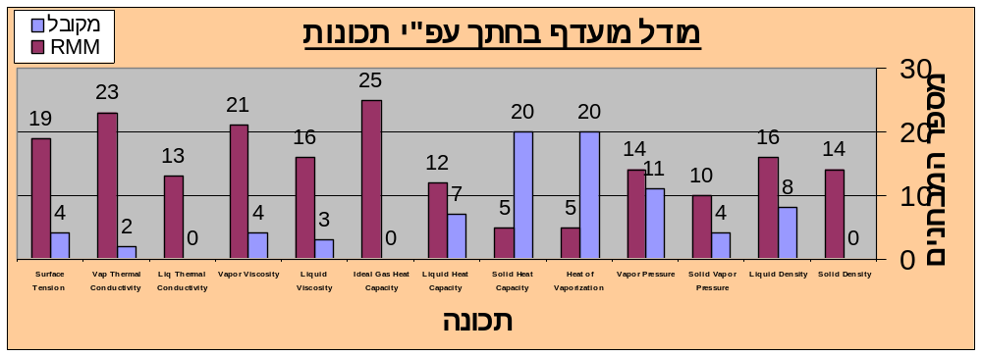
RMM Modeling in Chemical Engineering (Cont’d)
Preferred Model
(by property, across substances and goodness-of-fit measures)

Slide 38
RMM Modeling
Thank you
(shor@bgu.ac.il)

